Slide 1
Claims Management System
MFPE (POD - 2) INTCDE21IJ042
Team Members
Mentor :
Thiyagaraja T
Aitha Nikhil (921434)
Pathan Salman Khan (922131)
Sahithi GM (922134)
C Sumit Reddy (921617)
Trainer :
Nilay Das
Coach :
Keerthana Ganesh

Slide 2
Introduction
The Claims Management System provides Microservice Architecture based software solution.
It provides high Availability operations for their customer & organization without disruption.
Different Microservices combines together to perform together as a Uniﬁed application.

Slide 3
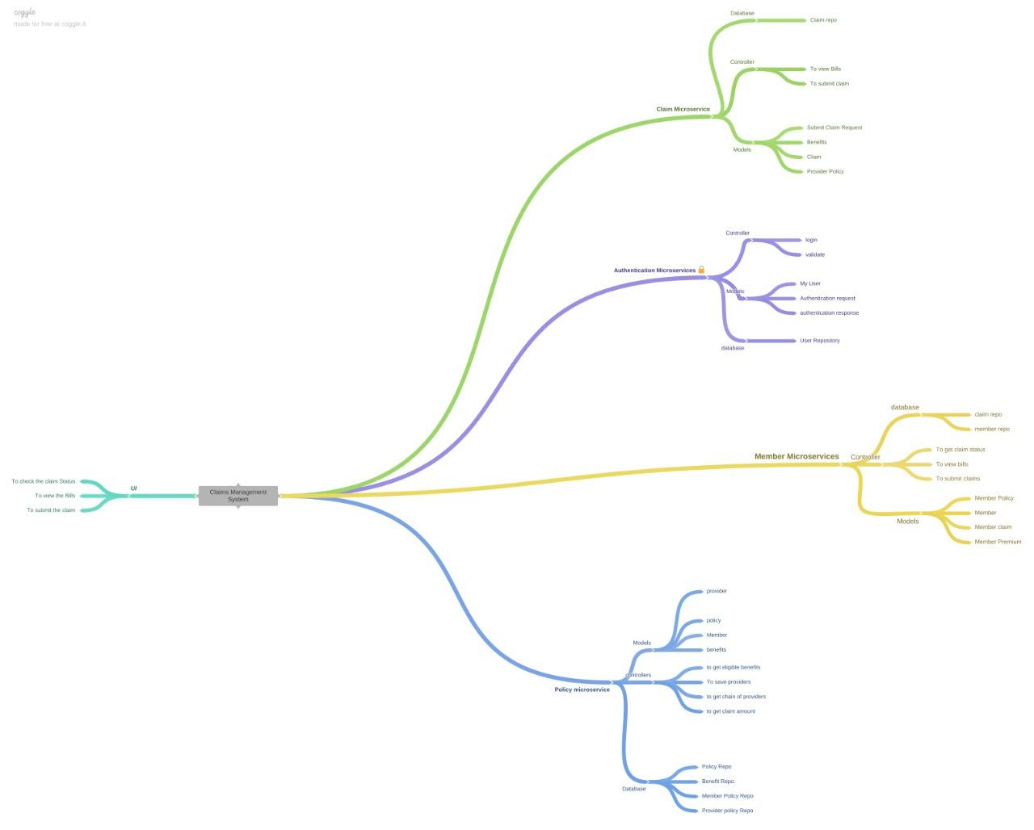
Architecture Diagram

Slide 4
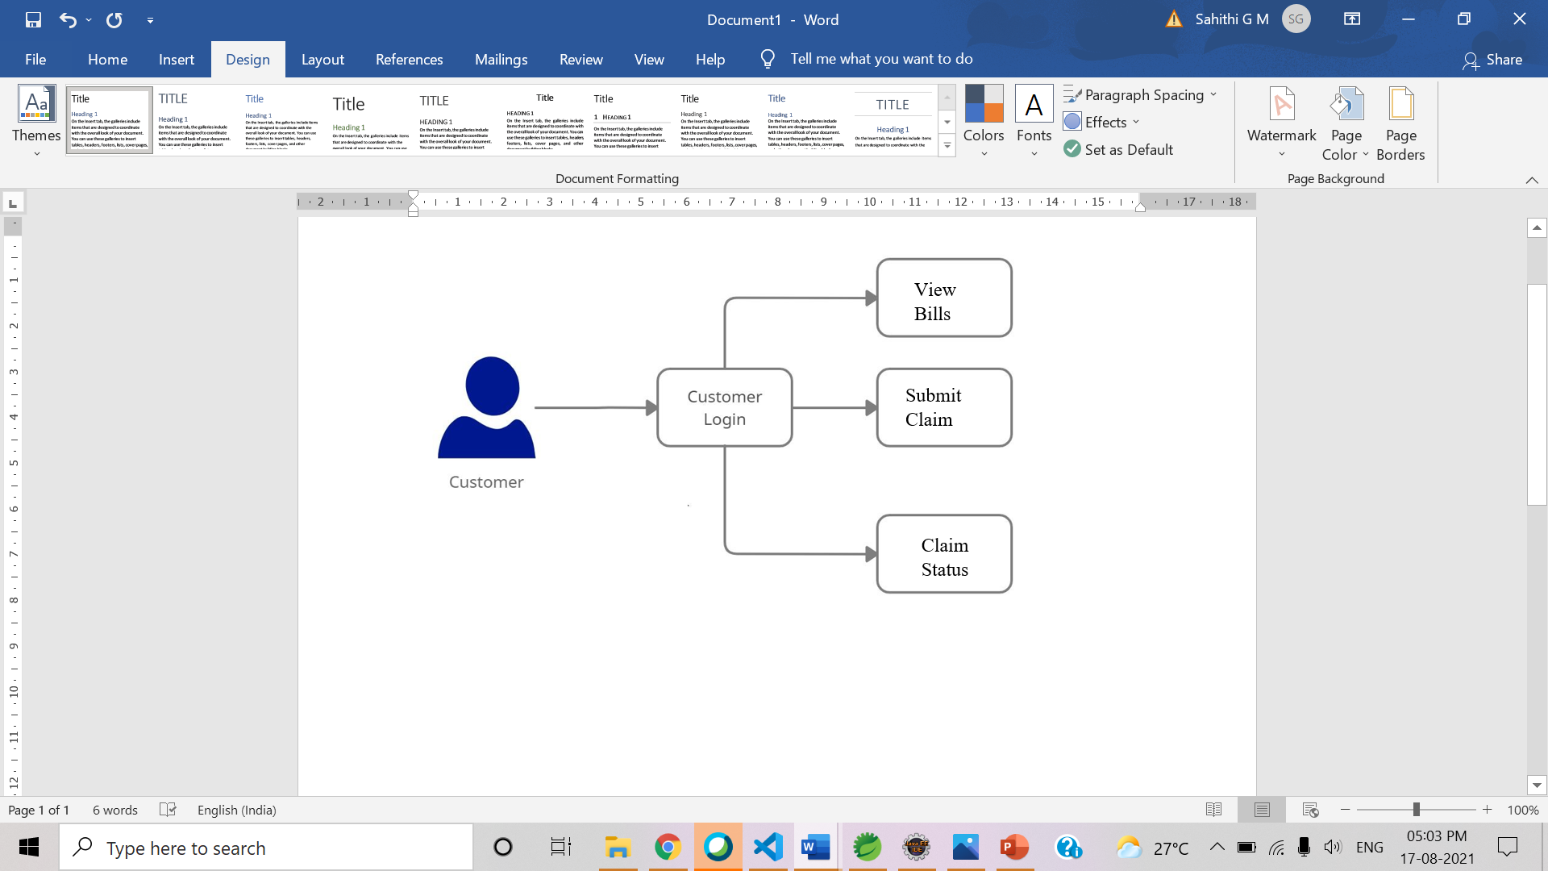
Architecture Diagram for Customer

Slide 5
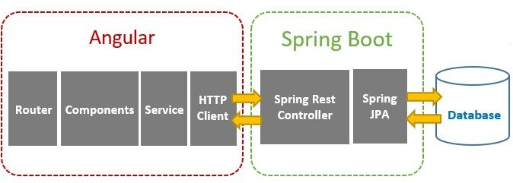
Client - Server Architecture

Slide 6
Technologies Used
Front End : Angular 8
Backend : Java, Spring Boot, Restful-Services
Database : H2 - database
Tools : Spring Tool Suite, Swagger, Postman, AWS

Slide 7
Working Microservices:
Authorization microservice
Claims microservice
Member microservice
Policy microservice

Slide 8
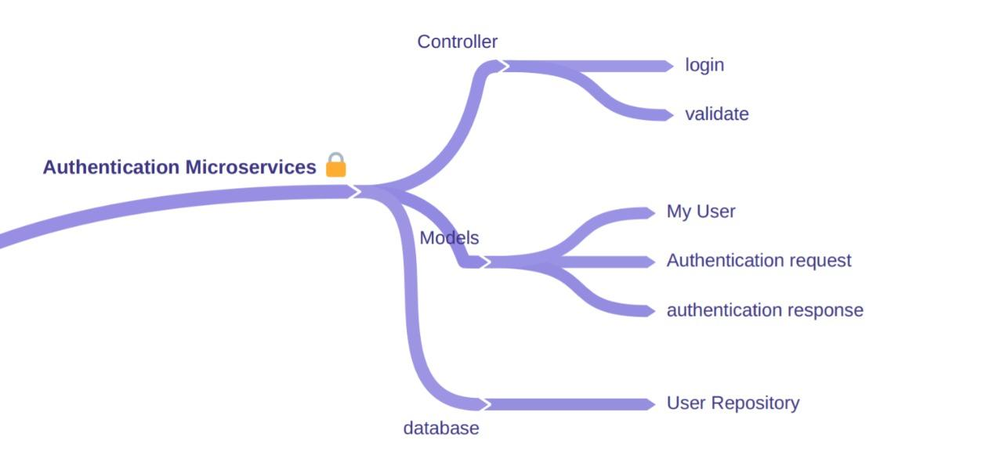
Architecture Diagram for Authorization

Slide 9
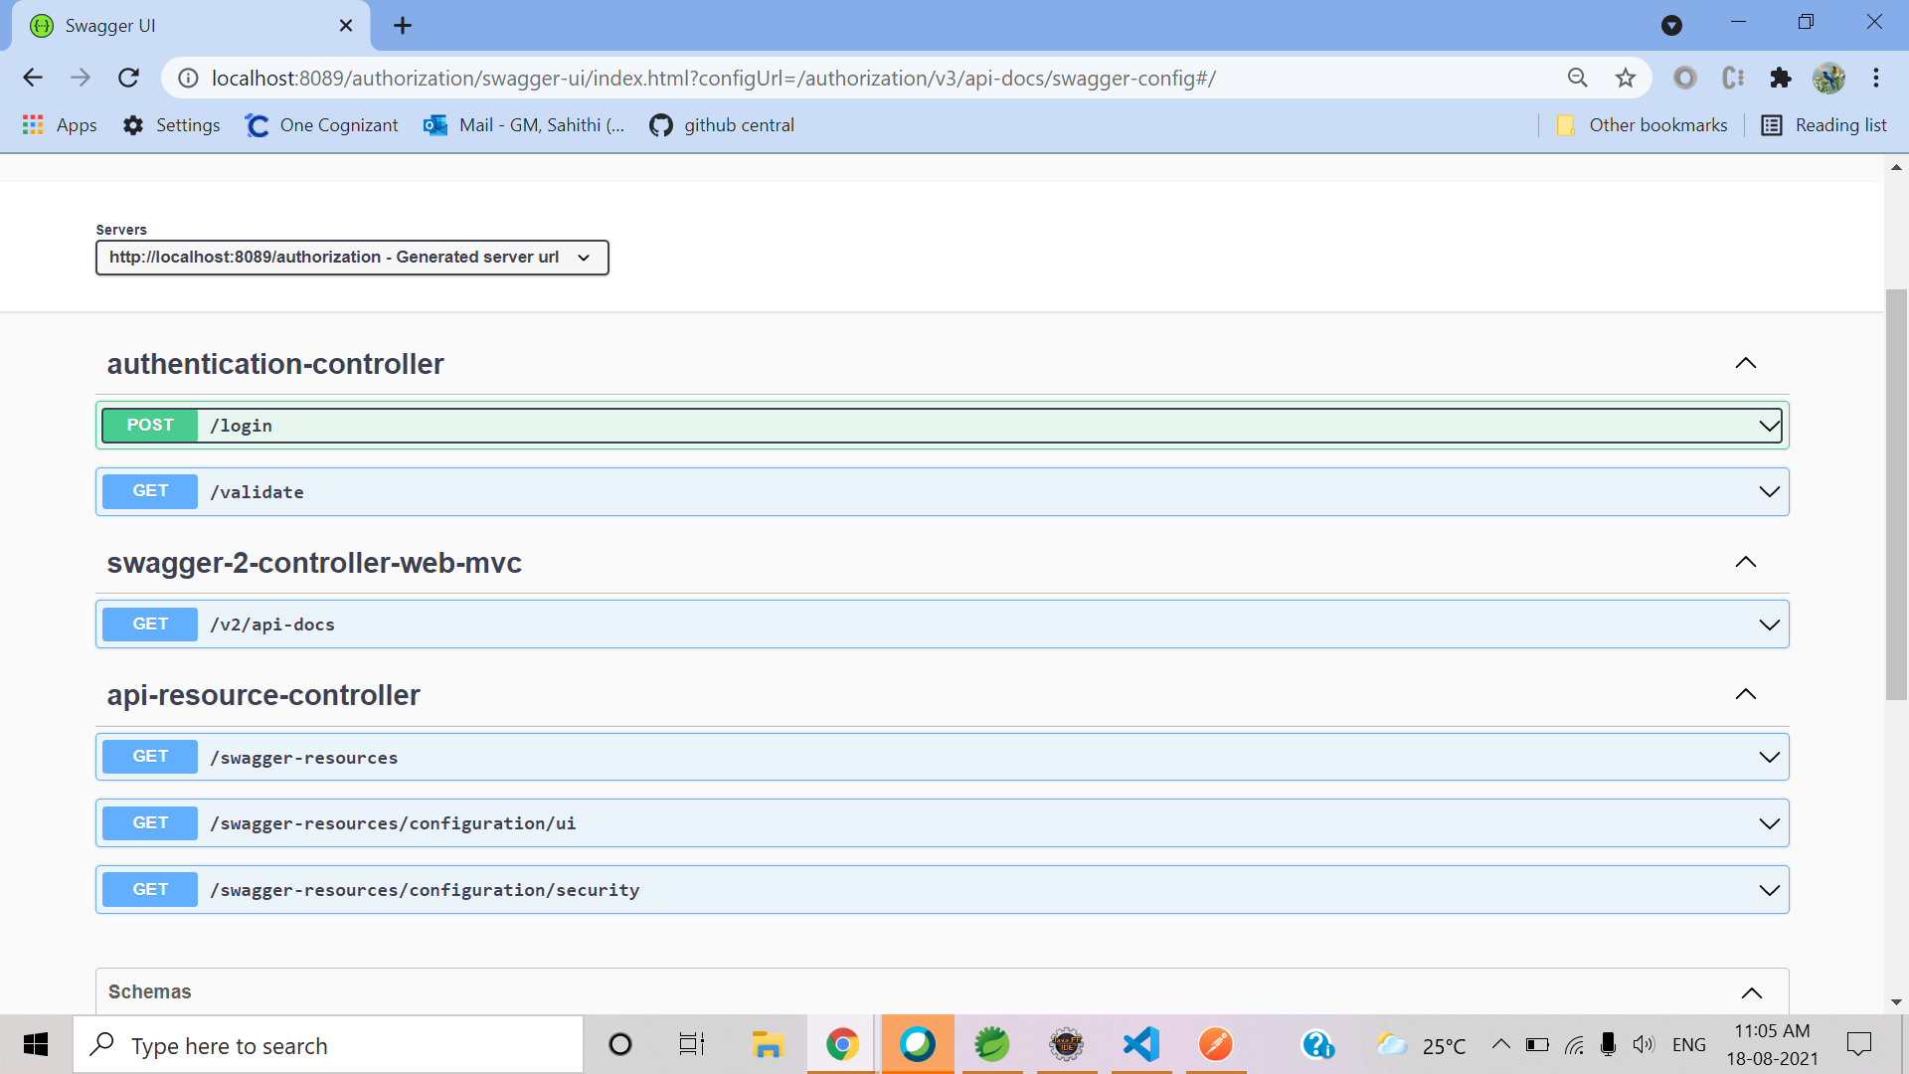
Swagger for Authorization

Slide 10
Authorization Microservice
Authentication Microservice will perform operations like:
Login &
Validate
Authentication will provide the JWT token after user’s validation.
Providing the authorization based on user’s login

Slide 11
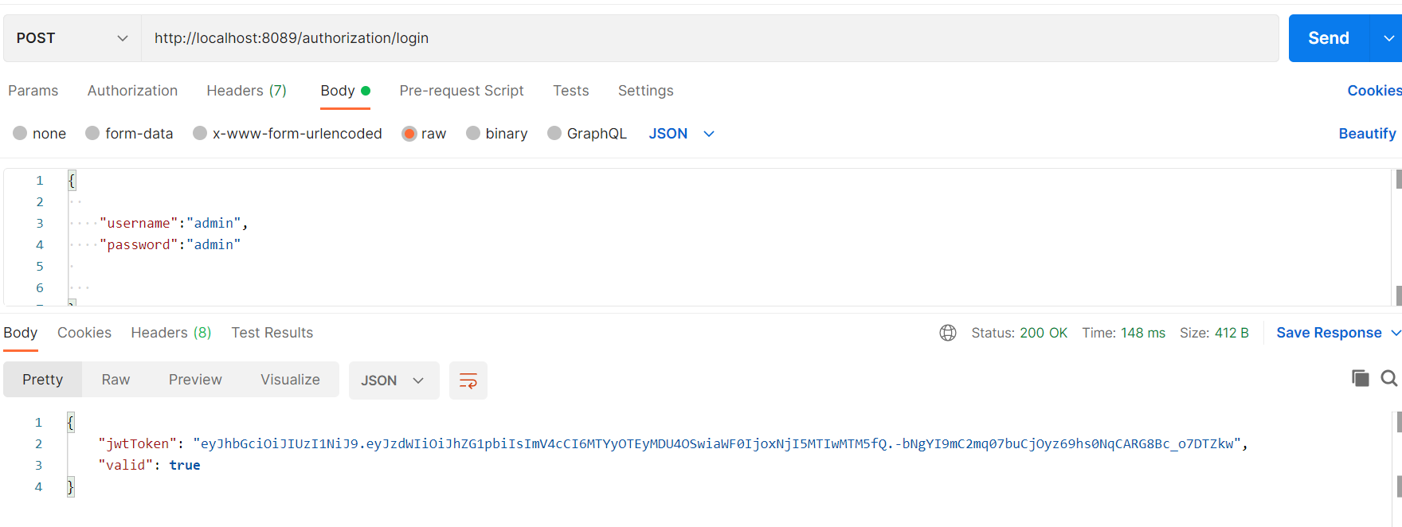
Authorization Microservice - Sample request

Slide 12
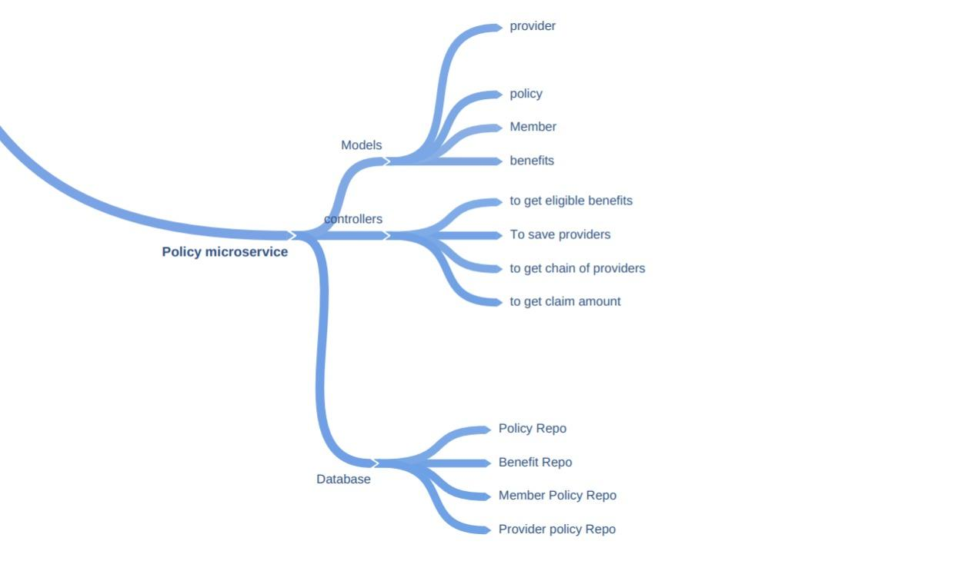
Architecture Diagram for Policy

Slide 13
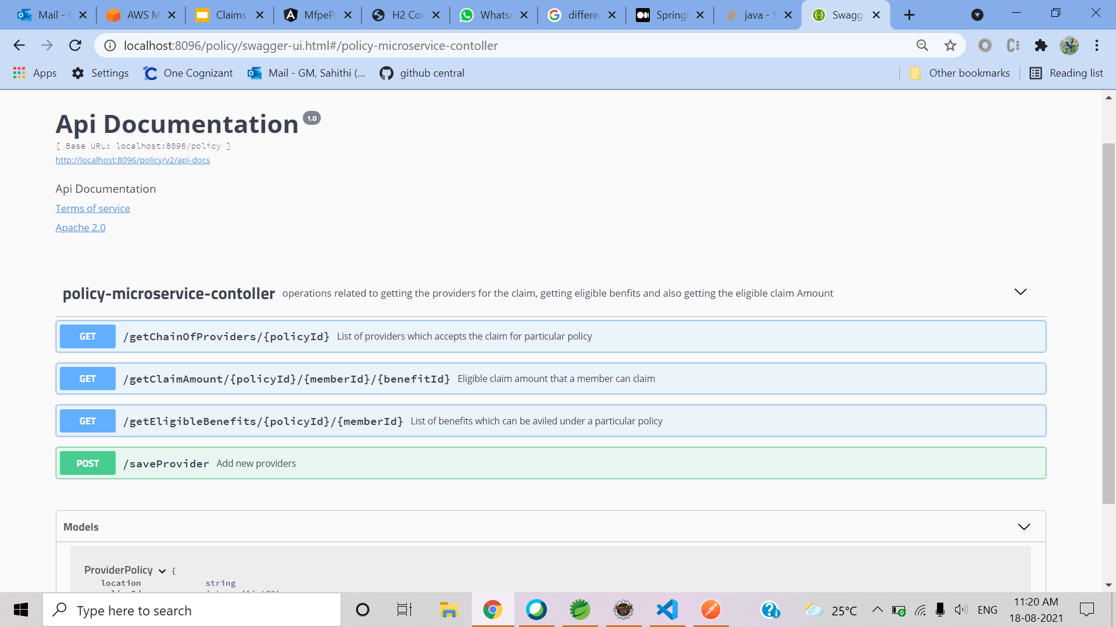
Swagger for Policy

Slide 14
Policy Microservice
Policy microservice will performs operations like :
Return the chain of hospitals
Provide the list of benefits which the member is eligible
To provide the eligible claim amount
It even interacts with authentication microservices to authorize user using JWT token.

Slide 15
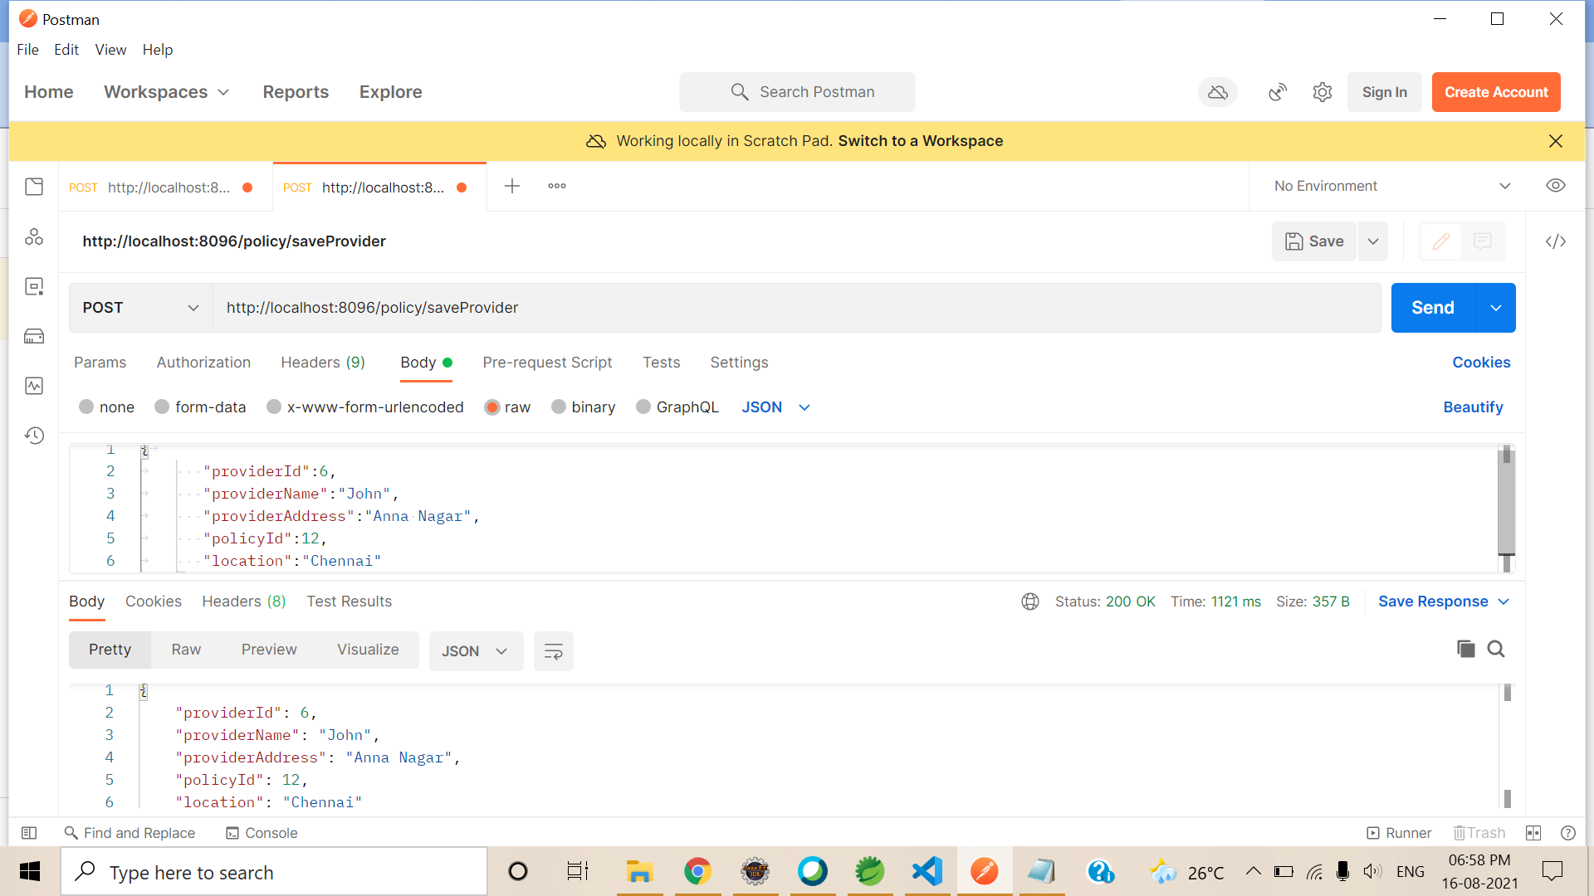
Policy Microservice - Sample request

Slide 16
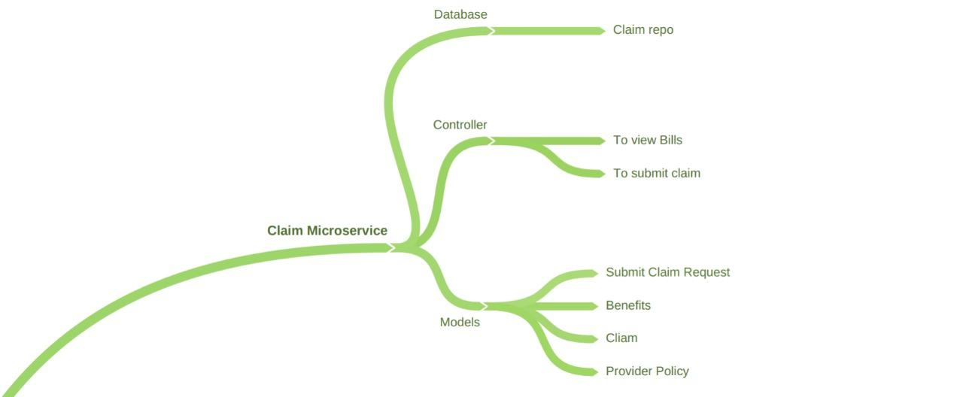
Architecture Diagram for Claims

Slide 17
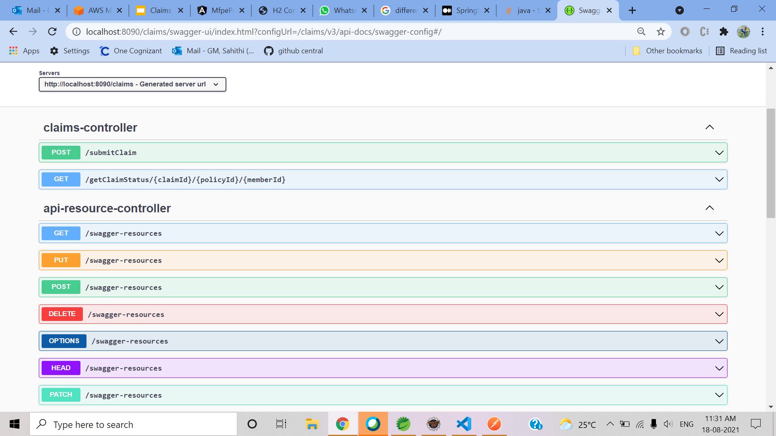
Swagger for Claims

Slide 18
Claims Microservice
Claims Microservice will perform following operations:
Retrieve the claim status from database and return
To submit new claim
It Interacts with authentication microservice to authorize users using JWT token.
It also Interacts with policy microservice to get chain of providers,eligible amount

Slide 19
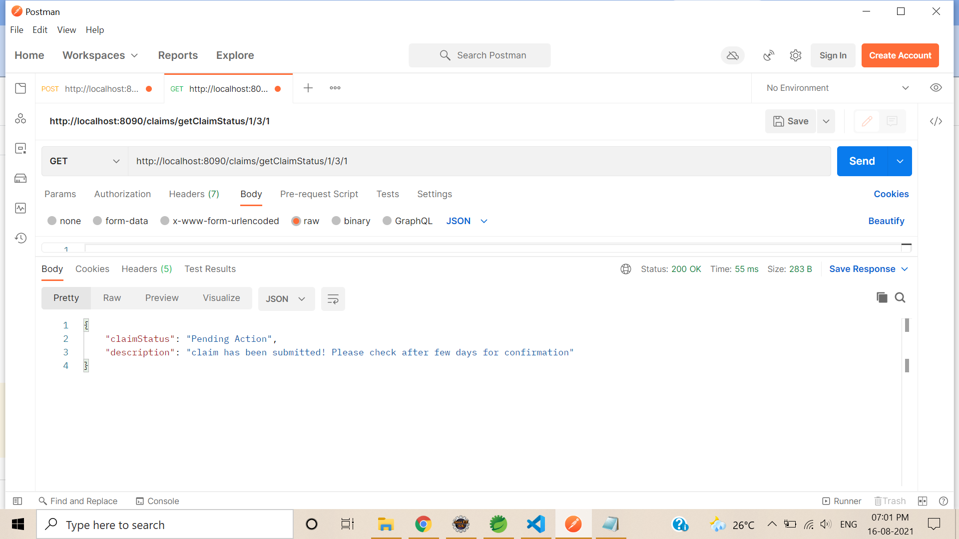
Claims Microservice - Sample response

Slide 20
Member Microservice
Member Microservices will perform operations like:
authorized member view the premium bills, submit the claim, can view the claim status, which is already submitted.
It will responsible to interact with UI
It Interacts with authentication microservice to authorize users using JWT token.
It Microservice will interact with Claims Module, to check the eligibility of the member and the claim, and then action the claim to set for processing.

Slide 21
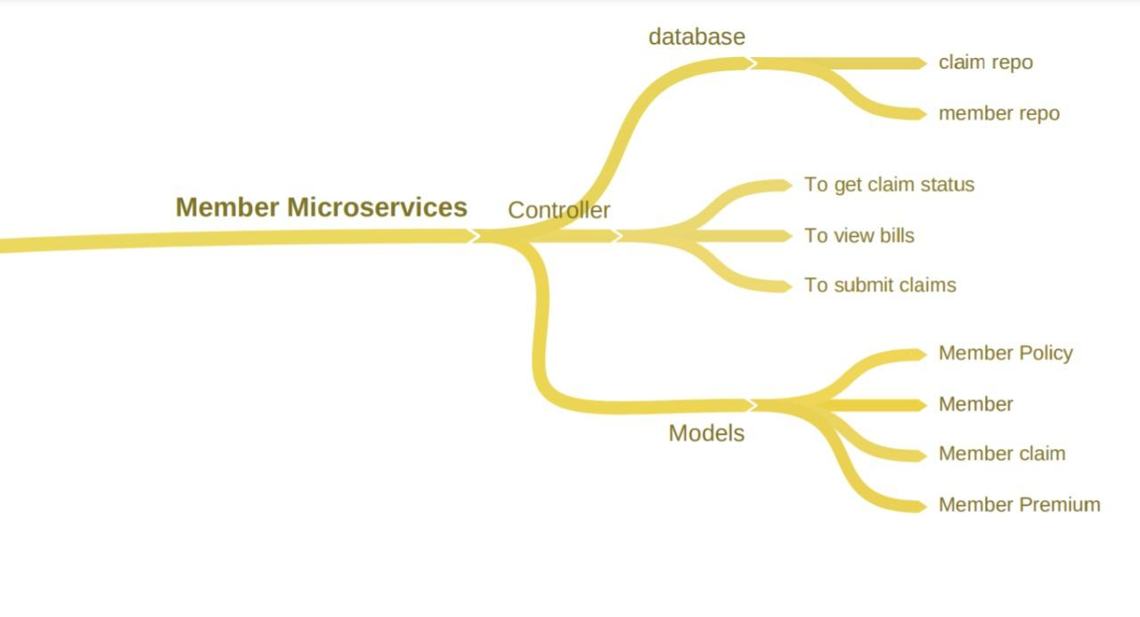
Architecture Diagram for Member

Slide 22
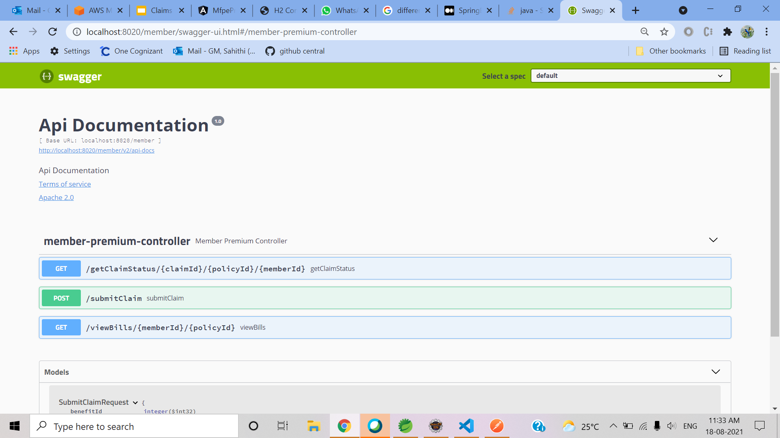
Swagger for Member

Slide 23
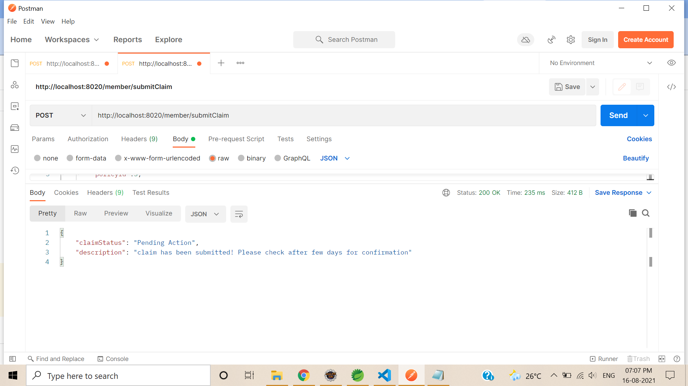
Member Microservice - Sample request

Slide 24
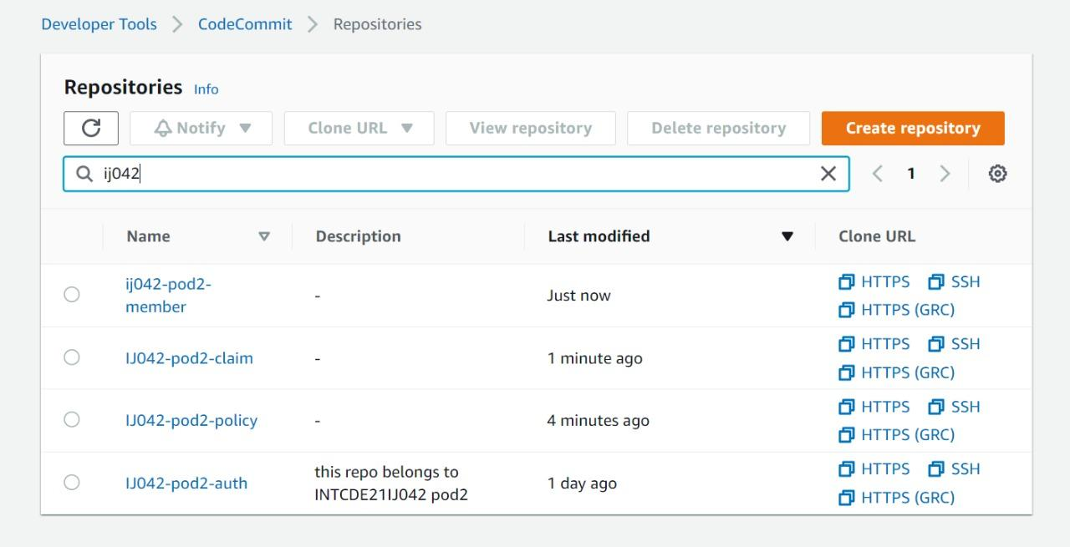
AWS Deployment
Code Commit :

Slide 25
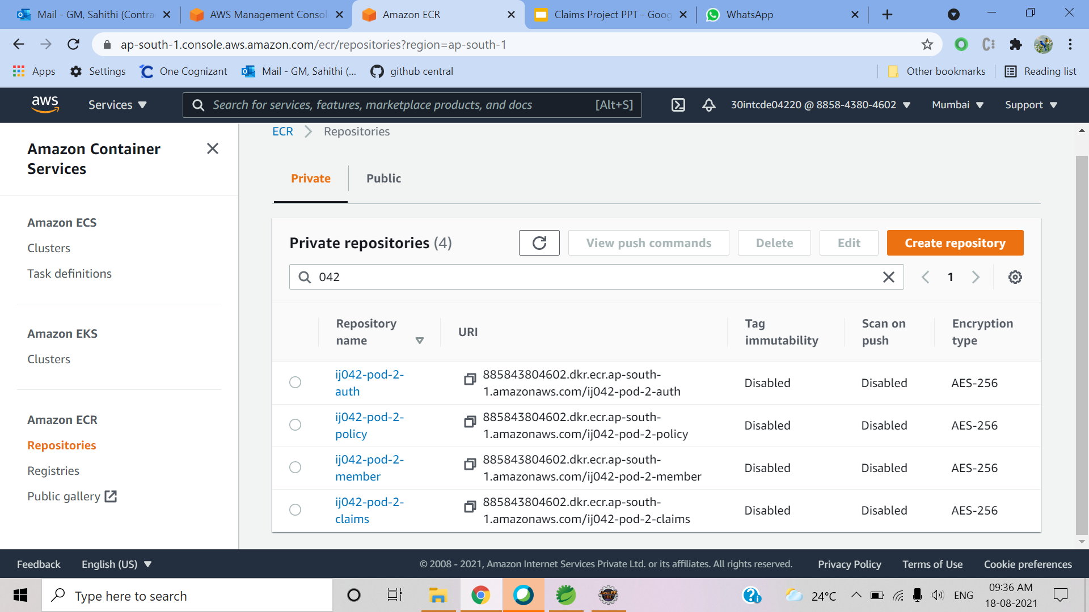
AWS Deployment
Elastic Container Registry :

Slide 26
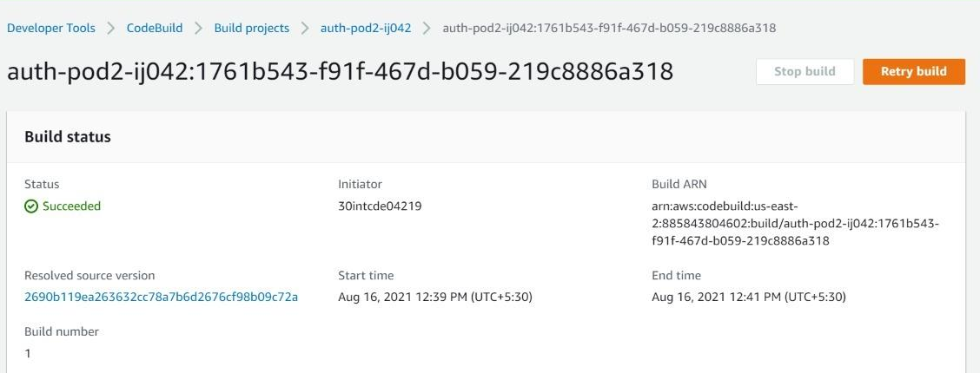
AWS Deployment
Code Build:

Slide 27
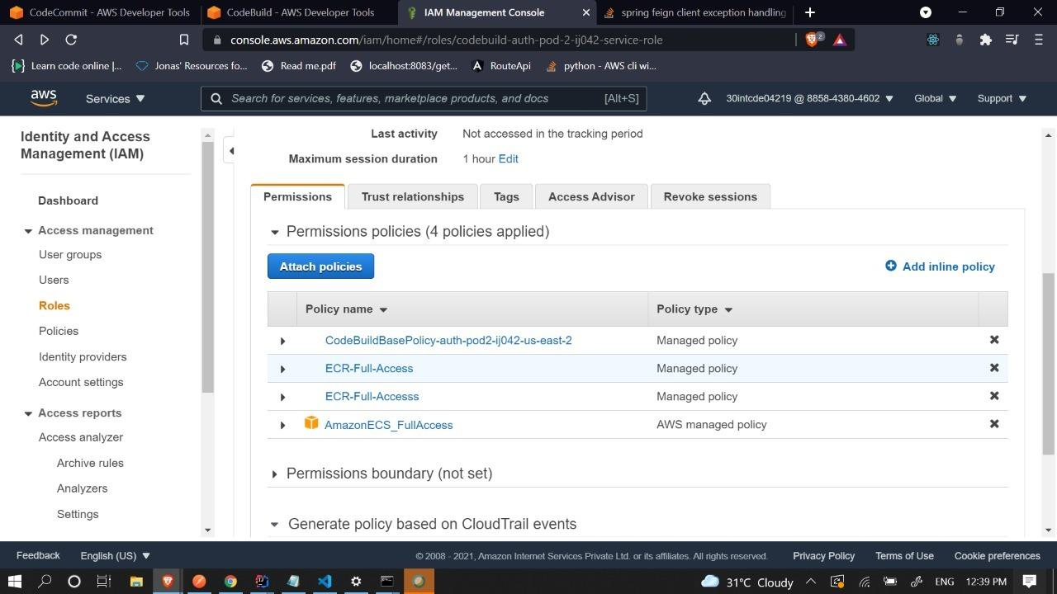
AWS Deployment

Slide 28
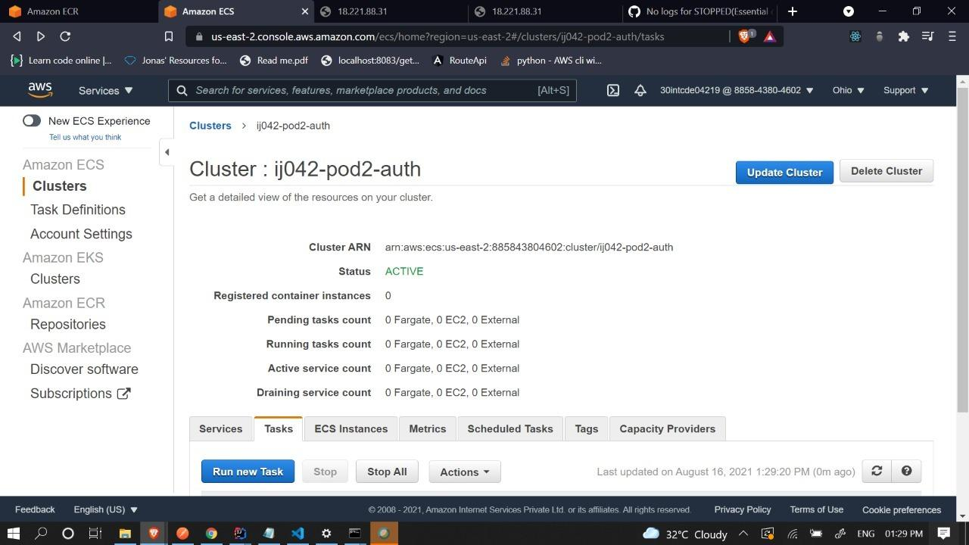
AWS Deployment
Cluster Services:

Slide 29
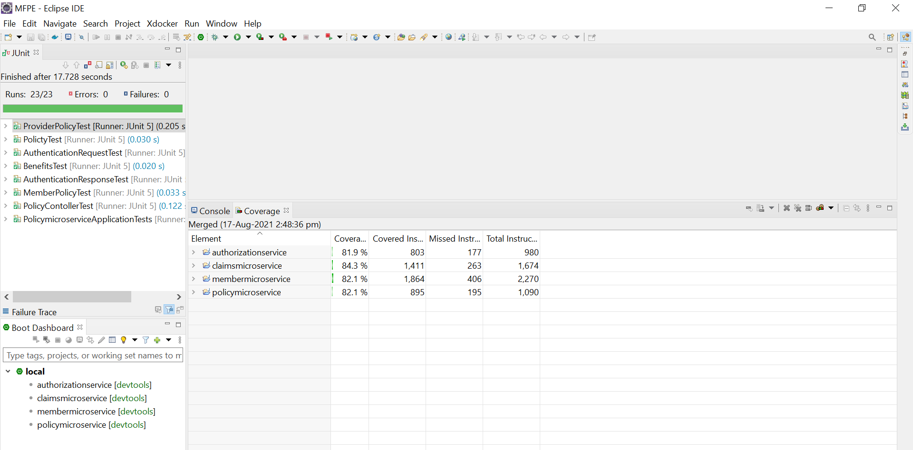
Unit testing and Code Coverage:

Slide 30
Video Sample:

Slide 31


Slide 32
Thank You ...!

